Slide 1
Supporting children and families during a pandemic (with special consideration for populations at increased risk)
Kara Murias
April 1, 2020
https://theadditionalneedsblogfather.files.wordpress.com/2020/03/hello-im-coronavirus.pdf

Slide 2
Objectives
1. Discuss how children, and children with disabilities, are at risk of increased physical and mental health concerns
2. Review how children with disabilities can present with trauma, abuse, or mental health concerns
3. Discuss supports for families and children
4. Cheesiest of cheesy jokes the internet has to offer

Slide 3
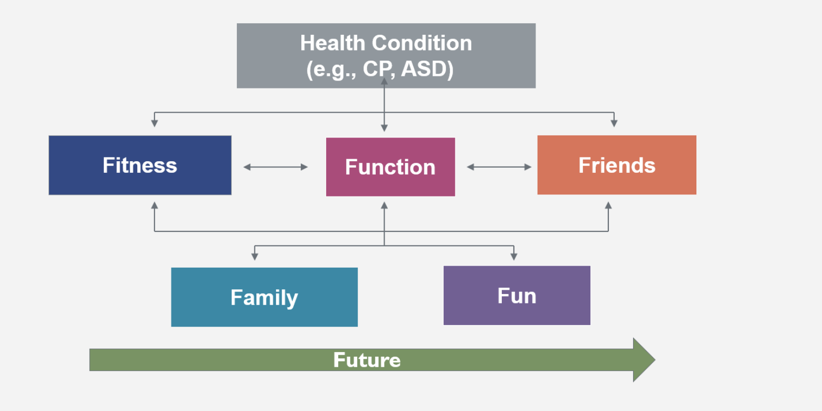
Risk to kids
Less likely to have severe disease
Social isolation
Loss of education, exercise, recreational opportunities
Fear, grief, uncertainty
Poverty and food insecurity
560,000 (8.2%) children in Canada living in poverty (StatsCan 2018)
Many children receive food supplementation at school
Notes:
systematic literature review identified 45 papers and letters published up to 18 March and this showed that children have so far accounted for 1-5% of diagnosed cases.
Although very few cases were young infants, this group seemed to be more prone to severe disease compared with older children: prevalence of severe and critical disease was 10.6% in children aged <1 at diagnosis, 1-5 years (7.3%), 6-10 years (4.2%), 11-15 years (4.1%) and 16-17 years (3.0%)

Slide 4
Risk of abuse and exploitation
Approximately one third of children referred to Children Services are referred through their school
Increased stress in household associated with increased risk of abuse or witnessing abuse
China had a three fold increase in domestic violence in Feb 2020
Possible decreased supervision or inappropriate supervision
Restrictions on social interactions and increase in internet use may cause increase in exploitation

Slide 5
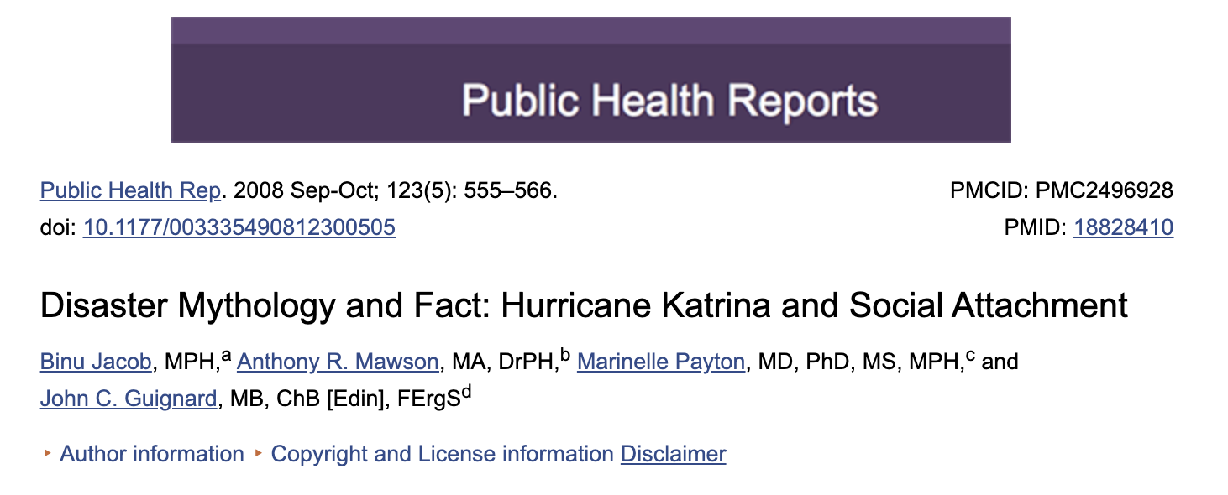
Disaster myth
As a group people actually have increased pro-social behaviour
If directed well can increase capacity and resiliency
Can be misdirected – cause other problems
Doesn’t always benefit everyone
Doesn’t account for outliers
Example scammers

Slide 6
Increased risk to children with disability
in other vulnerable populations
chronic disease
Factors already increased for children with disability at baseline that would be exacerbated in pandemic:
Social isolation: already experience isolation, now have fewer resources and more restrictions
Loss of education, exercise, recreational opportunities: limited opportunities require extra support that is now not available
Fear, grief, uncertainty: may be less able to understand changes
Changes in routine and schedule cause extra behaviour problems and mental health issues

Slide 7
Increased risk to children with disability
Poverty and food insecurity: families with children with disability are already at an economic disadvantage
Increased supervision and care demands
Risk of abuse and exploitation: children with disabilities at high risk of abuse
Decreased respite and support

Slide 8
Increased risk to children with disability
Possible increased risk to health with comorbidities – not known in COVID for children
Children that are immunocompromised – possibly less than other infections
Children with pre-existing respiratory disease, neuromuscular weakness, structural breathing limitations, etc. – no evidence in covid 19 but seen in other respiratory illnesses
Multiple caregivers - including people at possible higher risk (working in other healthcare settings)
Some things needed to take care of children with disability are in short supply
Ludvigsson 2020; Acta Paed. doi:10.1111/APA.15270
Notes:
Of 171 children treated at Wuhan Children’s Hospital, three (1.8%) required intensive care and all of those had underlying diseases. There was one case of hydronephrosis, one child was undergoing chemotherapy for leukaemia and another had intussusception.
this review was unable to identify any study that quantified the prevalence of comorbidities in children.
People with a learning disability have higher rates of morbidity and mortality than the general population and die prematurely. From UK NHS report: in 2018/19 at least 41% of people with a learning disability who died, died as a result of a respiratory condition

Slide 9
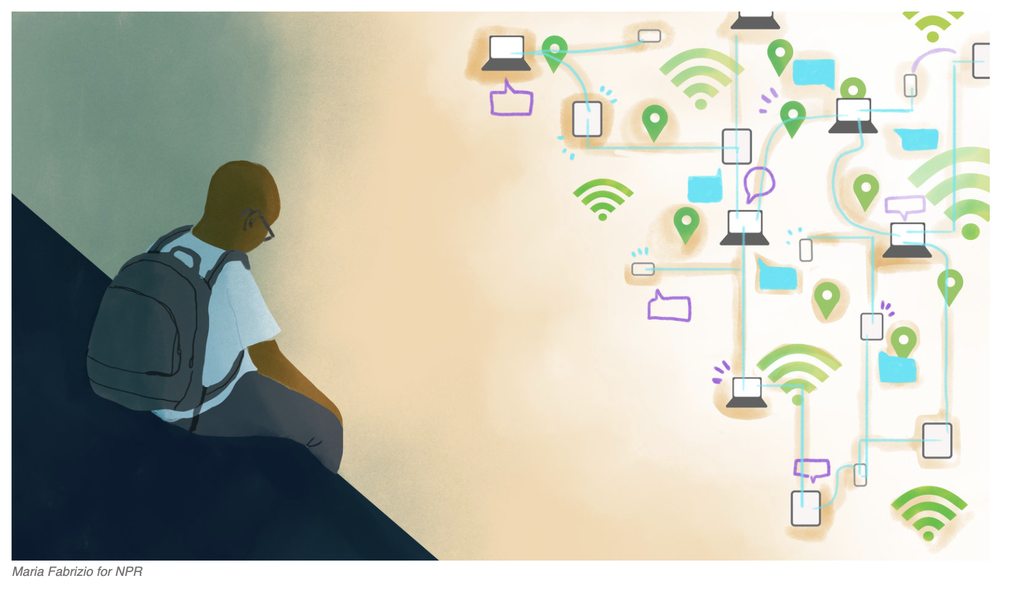
Other things to consider
Caregiver burnout
Family stress and possible breakdown
Not all people have the same access to assistance and accommodations during restrictions
English language learners
Reduced digital access or knowledge
Children at risk are cut off from outside sources of monitoring

Slide 10
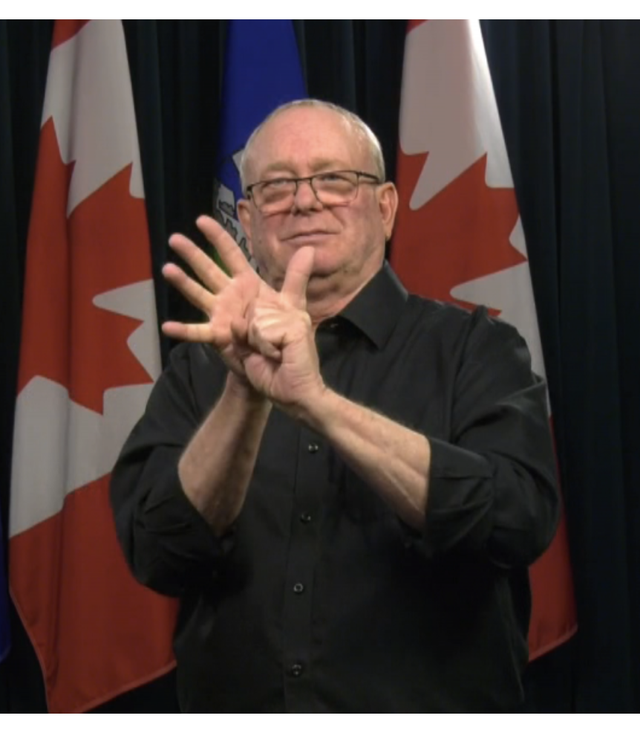
Other things to consider
Children and families affected by disabilities may be feeling more vulnerable due to talk of utilitarian ethics
Emergency planning may not have considered accessibility
Rapidly increasing employment – people who had drug coverage before may have lost

Slide 11
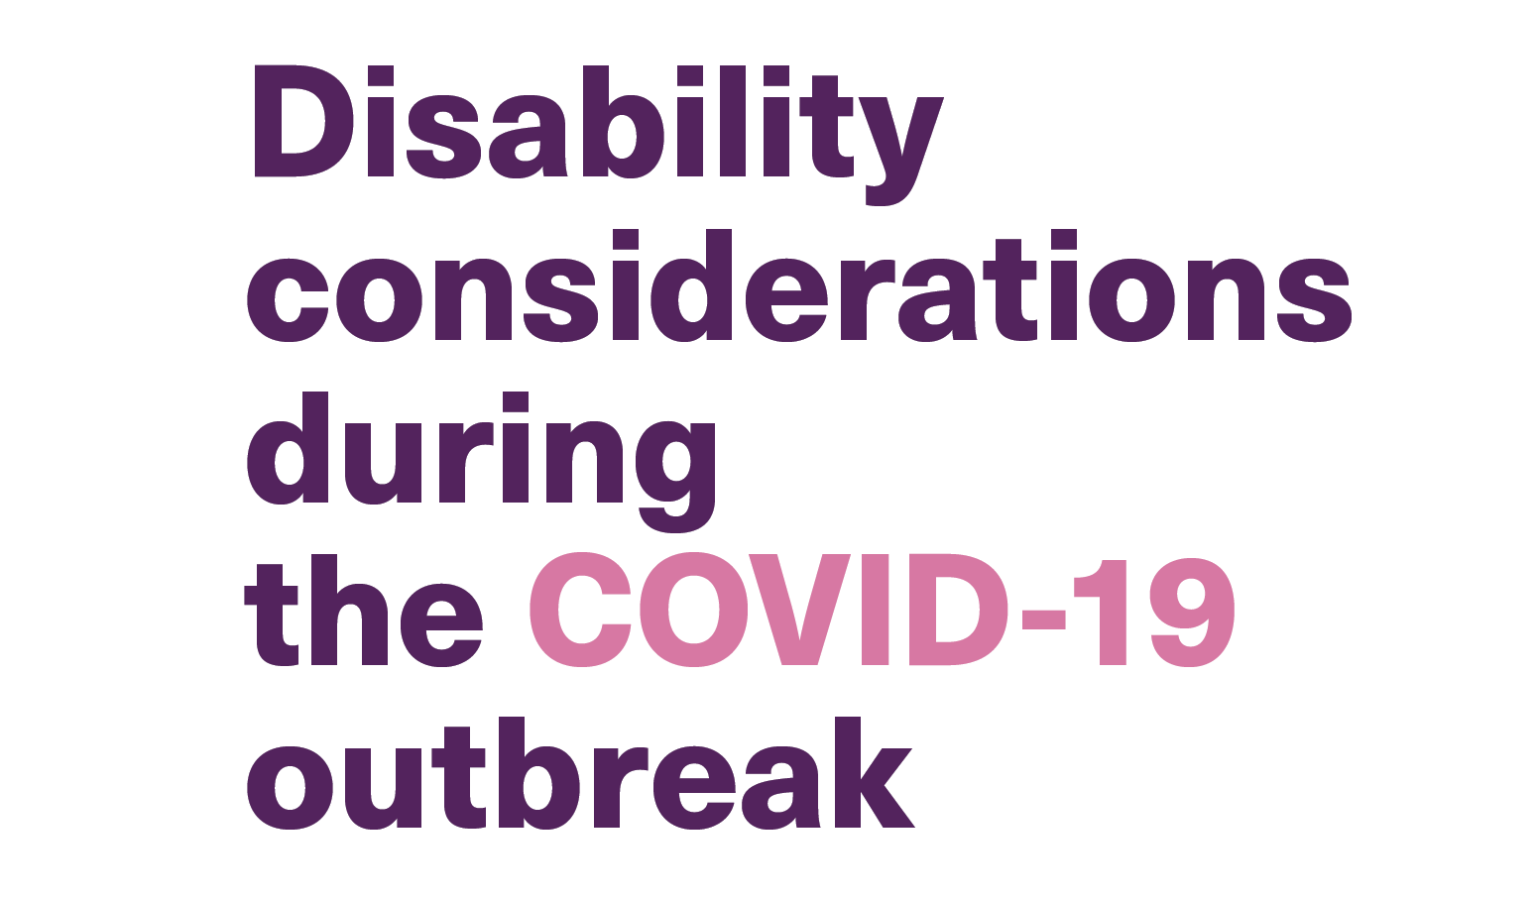
Response to vulnerable populations
There has been recognition at all levels that emergency measures and response should not exclude or discriminate against vulnerable populations
https://www.england.nhs.uk/coronavirus/wp-content/uploads/sites/52/2020/03/C0031_Specialty-guide_LD-and-coronavirus-v1_-24-March.pdf
https://www.who.int/who-documents-detail/disability-considerations-during-the-covid-19-outbreak

Slide 12
How children may indicate distress
Increased worry or sadness, become withdrawn
Change in eating or sleeping habits
Difficulties with attention or concentration
Increased opposition, tantrums, irritability
Somatic symptoms such as pain

Slide 13
How children with disability indicate distress
Apparent regression
Increase in perseverating, repetitive, rigid behaviours
Increased in indecisiveness, hyperactivity
Increase in unusual fears / uncommon phobias
Aggression and self harm

Slide 14
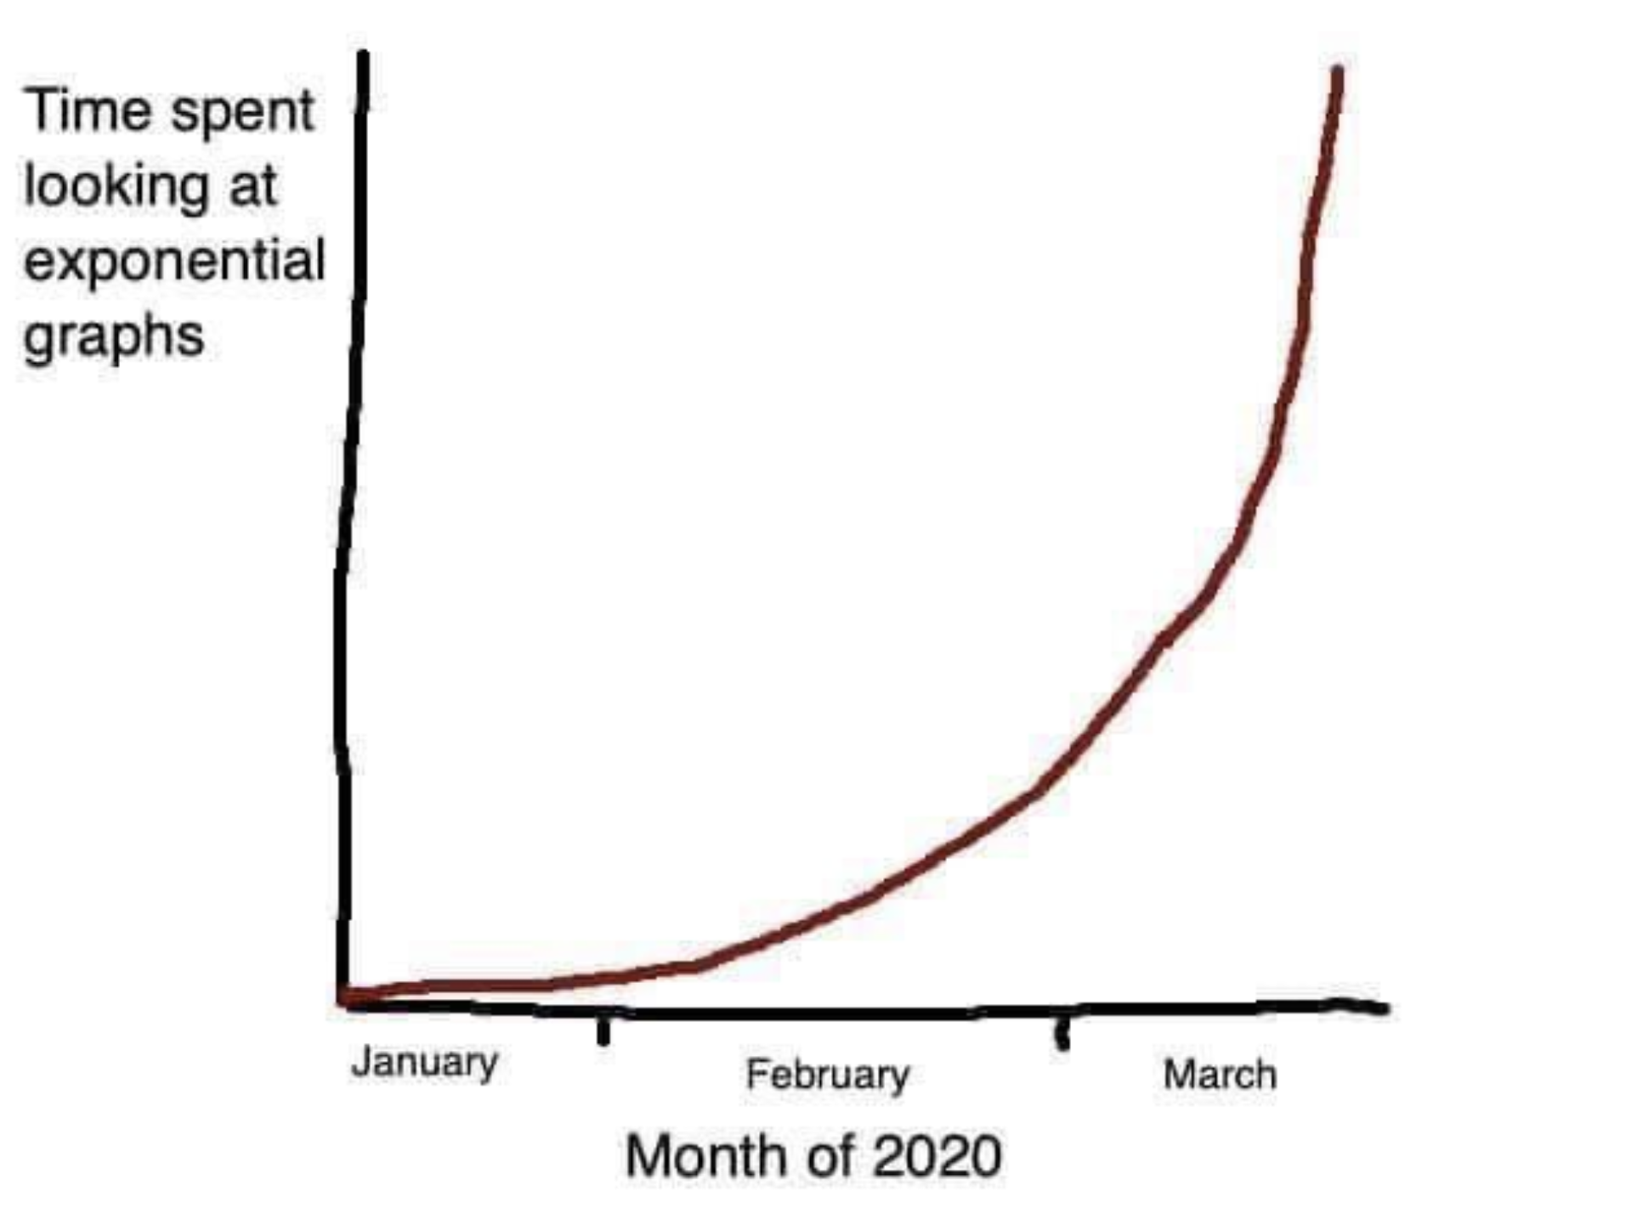
Advice to families
Needs to be as concrete and specific as possible but flexible to the families needs/capabilities
Set (realistic) routines and scheduled
Find ways for kids to stay connected to family, friends, school
Find ways to help that are meaningful to kids
Set age-appropriate limitations on media
Have a screen strategy
Watch for signs of stress in child: teach parents what this may look like
Model healthy patterns and coping strategies
Physical activity
Coping strategies
Notes:
Avoid frequent updates and perseverating on negative news
Distract with other activities
Watch for signs of stress in child
Model healthy patterns and coping strategies
- Physical activity
- Spend time outside
- Teach specific anxiety coping strategies

Slide 15
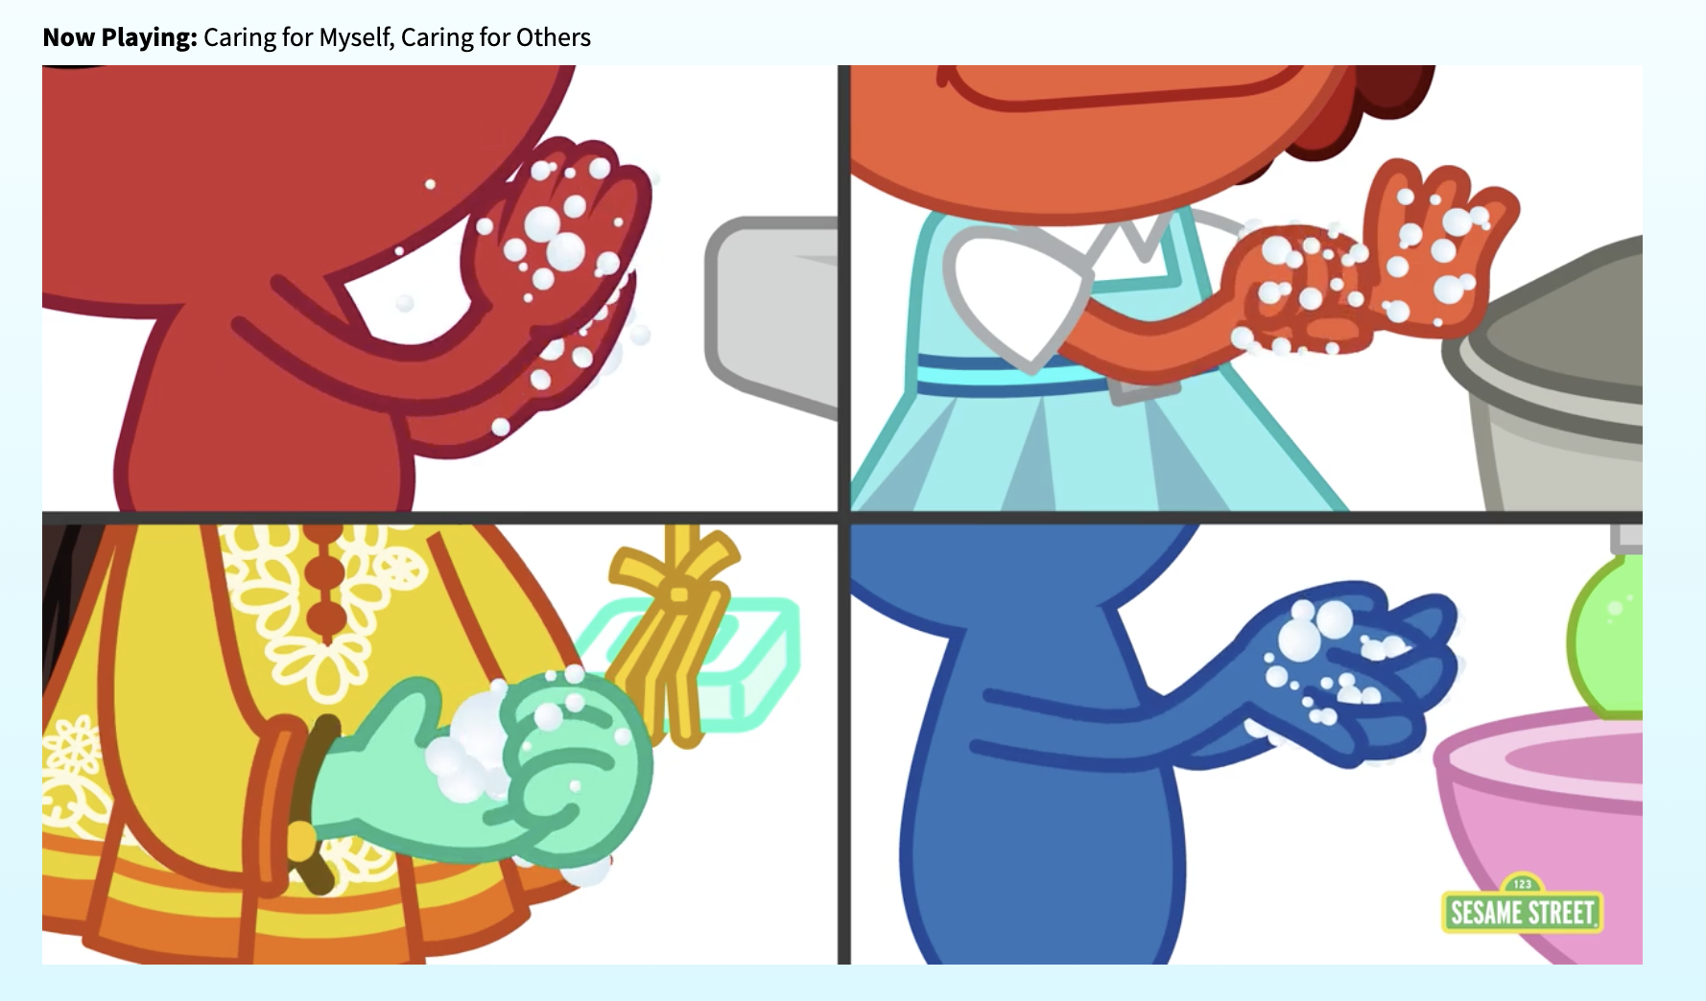
How to talk to kids about covid and crisis
Be calm and reassuring
Be available: Allow time and space for kids to talk, ask questions, and discuss feelings
Provide age-appropriate information
Provide honest and accurate information
Teach them the things they can do: appropriate hygiene and physical distancing
Notes:
Be calm and reassuring
- Most children are sensitive to the anxiety and stress in their family. Manage your own anxiety, work to stay healthy and take breaks when needed.
- Reassure them that people are working hard to help and keep people safe
- Don’t blame others. Don’t stigmatize those that are sick or use language that targets other groups of people.

Slide 16
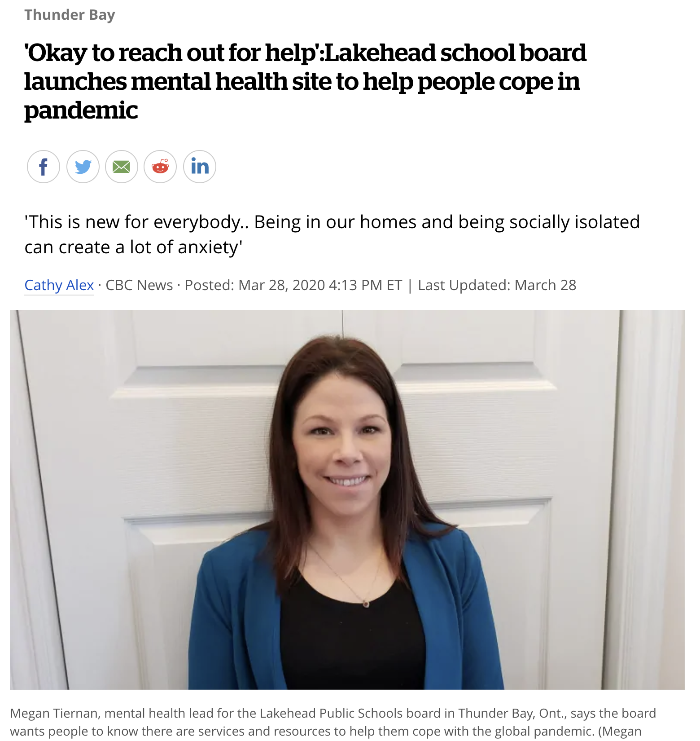
Mental health supports
Emergency and crisis support
Supports through existing relationships
Online and remote supports
Notes:
The Lakehead Public Schools board in northwestern Ontario has launched a new mental health portal on its website to help students, staff and families cope with the impact of the "unprecedented experience" of living through a global pandemic.

Slide 17
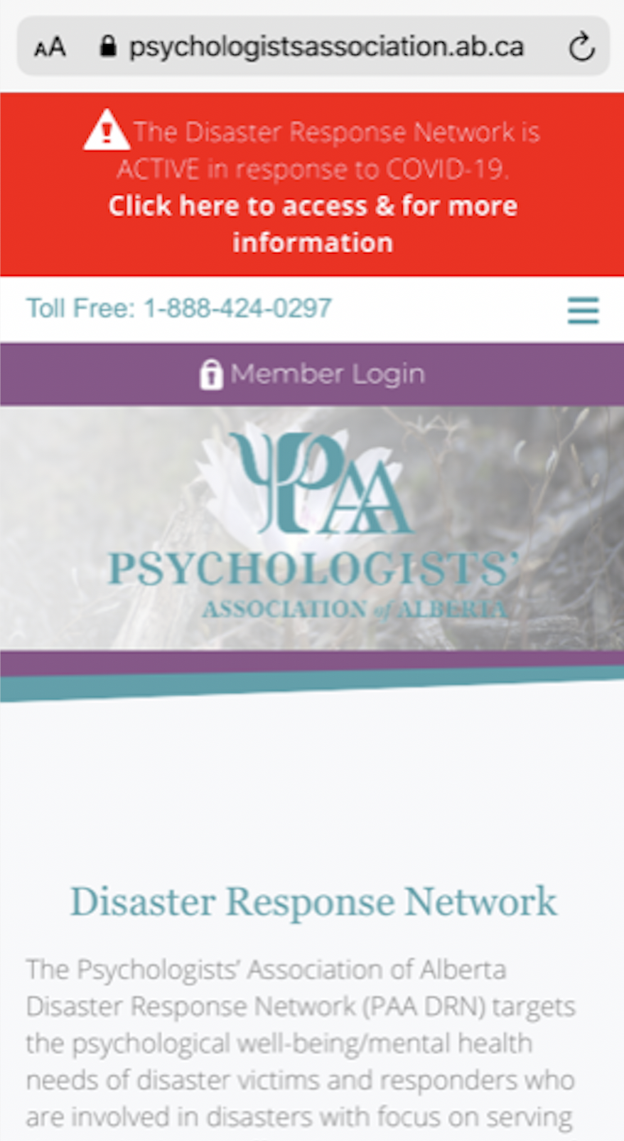
Anxiety counselling for children/families
Information on psychoeducational support and coping strategies
Options for online direct contact and telehealth counselling
Anxietycanada.ca
Notes:
Our Disaster Response Network members are offering pro-bono psychological services with priority for health care providers and first responders traumatized by recent events. This is not a crisis line or a referral service but pro-bono support by volunteer psychologists of 1-3 sessions for those in need.

Slide 18
Emergency supports
May be less inclined to seek help out of fear for Covid
Options for immediate emergency help easily available

Slide 19
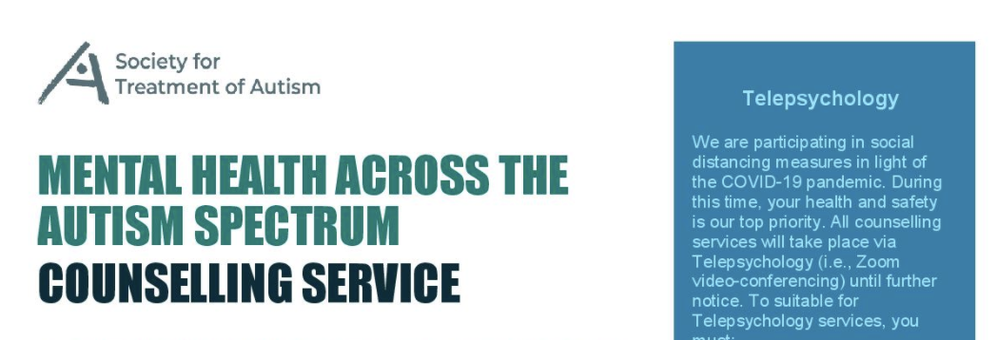
Supports for children with disabilities
Many existing support organizations have stopped regular programs but are available for family support – encourage people to reach out
Community and Social Services has indicated that they will allow more flexibility in use of FSCD funds - but there will be no increase
Funding cut for education support services, including education assistants

Slide 20
Education supports
Both basic and multimedia education online

Slide 21
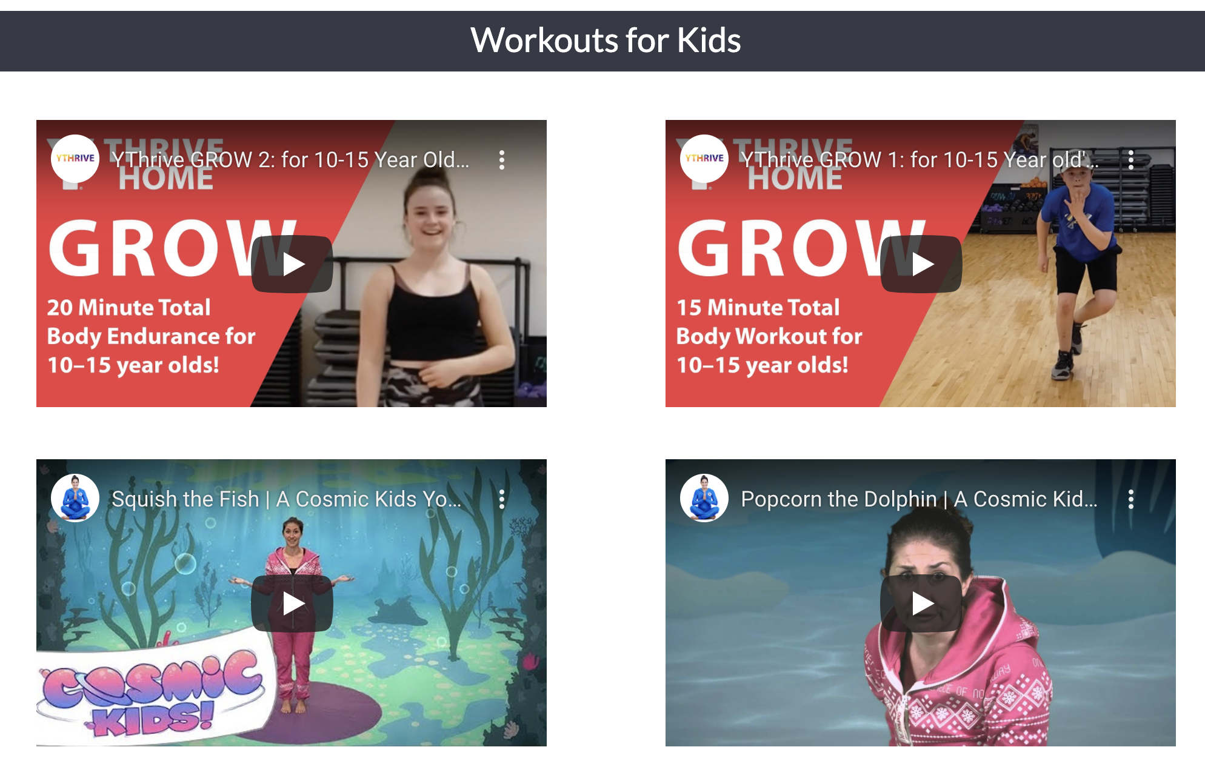
Sometimes: distraction
https://virtualy.ymcacalgary.org/body/

Slide 22
Long-term effects and fall out
Delayed diagnosis and treatment
Reduced resources and further constraints
Ongoing trauma and anxiety
Implications of long-term economic downturn
Many non-profit organizations also have decreased fund raising and increased costs

Slide 23
Opportunities
The move to alternate processes and accessibility may have long-term benefits for vulnerable populations
Heightened sensitivity to accessible methods of connection + exposure of system inadequacies could improve processes for children with disabilities
Overall improvement in healthcare and health related science will have benefits in pediatric and rare disease
Collaboration, open science

Slide 24
Summary
Children at less risk of illness but at increased risk of secondary effects of pandemic: some we can anticipate, others we may not
Children with existing vulnerabilities likely have amplified risk
The hardships of disease and restrictions are to felt evenly
Cannot assume other safety nets are in place
Ask – stay open and curious
Have emergency resource information available in multiple formats
https://www.childdevelopmentresearch.ca/parent-community-resources

